Slide 1
Change the World with
“Onigiri” Rice Balls

Slide 2
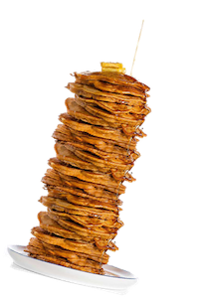
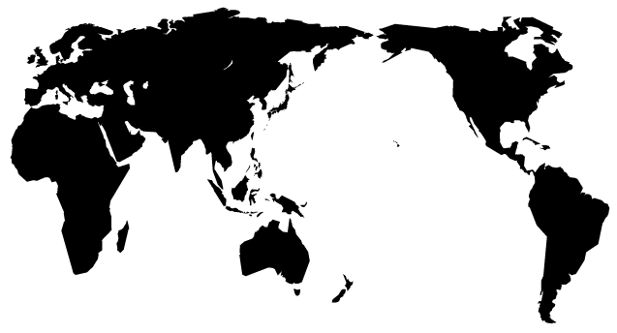
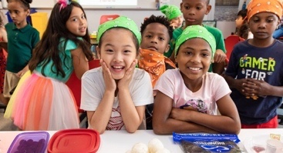
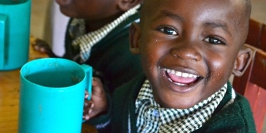
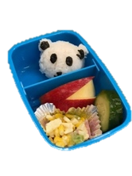
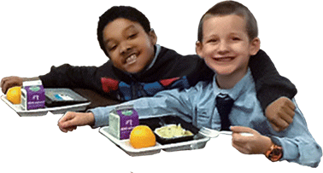
Mission of TABLE FOR TWO
In our world of 7 billion, 1 billion suffer from hunger, while 2 billion suffer from obesity and other health issues related to unhealthy eating.
Excess Unhealthy Food
Inadequate Food
2Billion
1Billion
GLOBAL FOOD IMBALANCE
TABLE FOR TWO USA rights this Global Food Imbalance
by promoting Healthy Eating and healthy School Meals to children in need.
Healthy Eating
School Meals
Notes:
World population is 7 billion and (Click) 1 billion people are hungry. While 1 billion are hungry, (Click) 2 billion suffer from obesity, diabetes, and other and other health related issues related to unhealthy eating This global food imbalance is not just in other countries, but is also happening here in the US.

Slide 3
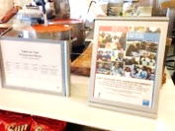
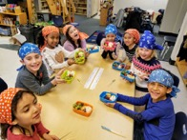
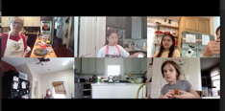
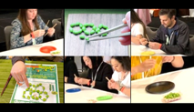
TABLE FOR TWO USA’s Programs and Campaigns
School Meals
Food Education
Year Around
Year Around
1. Meal-Sharing Program
3. Wa-Shokuiku Learn. Cook. Eat Japanese!
CAFETERIA, RESTAURANT
VENDING MACHINE
IN-PERSON
ONLINE
For every healthy “TFT Meal” sold, $0.25 is donated to help providing one healthy school meal to children (US or East Africa).
Washoku (Japanese food) + Shokuiku (Food Education). Students learn about healthy eating through Japanese food.
Fall Campaign
Spring Campaign
2. ONIGIRI ACTION
4. #EdamameChamp
SCHOOLS
EVENTS
Promote healthy eating through Japanese cuisine focusing on edamame & Soy. A fun chopsticks competition using edamame!
Every onigiri post to social media (or the campaign website) with #OnigiriAction
provides 5 school meals to children in need.

Slide 4
Oct 16th is World Food Day!!
World Food Day is an international day celebrated every year around the world on 16 October in honor of the date of the founding of the Food and Agriculture Organization of the United Nations in 1945. The day is celebrated widely by many other organizations concerned with food security in over 150 countries.
★
Notes:
World Food Day is an international day celebrated every year around the world on 16 October in honor of the date of the founding of the Food and Agriculture Organization of the United Nations in 1945. The day is celebrated widely by many other organizations concerned with food security in over 150 countries.

Slide 5
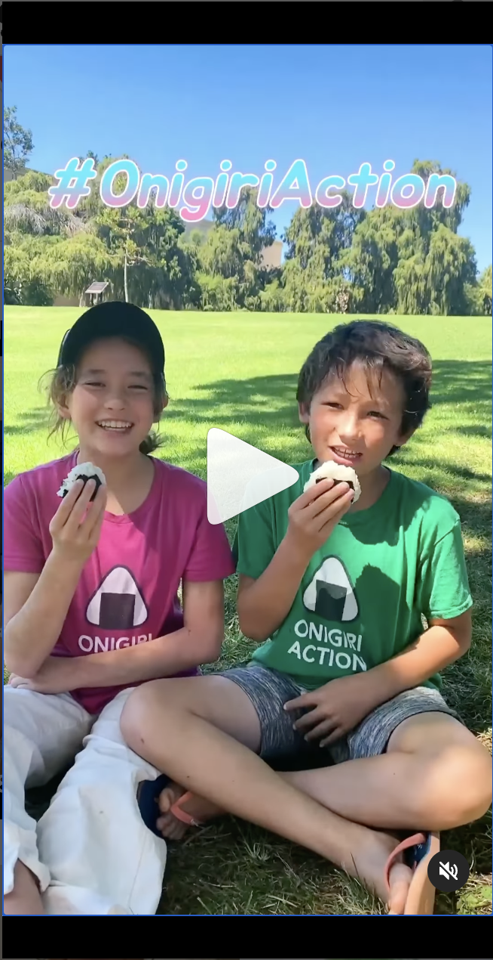
What is ONIGIRI ACTION: How it Works
https://youtu.be/uqrTciksbE0

Slide 6
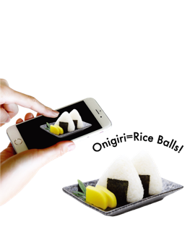
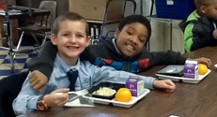
What is ONIGIRI ACTION: Oct 4th to Nov 17th 2023
Change the world with “onigiri” rice balls!
During the campaign,
every onigiri related post
to social media (or the campaign website) with #OnigiriAction
provides 5 meals to children in need
around the world.
★
Notes:
Every year, TABLE FOR TWO launches the ”Onigiri Action” Campaign to celebrate World Food Day, which honors the date of the founding of the Food and Agriculture Organization of the United Nations in 1945. During the campaign, every photo of an onigiri posted to social media (or the campaign website) with #onigiriaction provides 5 meals to children in need in Africa, Southeast Asia, and North America. Even a simple action can have a big impact around the world!

Slide 7
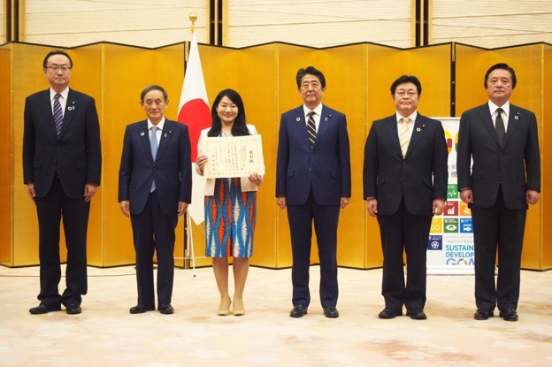
What is ONIGIRI ACTION: Partners, SDG Awards
You just post your onigiri photos,
then our generous partner organizations will donate!
Our 2023 Partners in the U.S.
Since its launch in 2015, ONIGIRI ACTION Campaign has provided
8.3 millions school meals!
The campaign received the Deputy-Chief’s Award (by the Minister for Foreign Affairs) at the third Japan Sustainable Development Goals (SDGs) awards ceremony 2019 held at the Prime Minister’s Office.
★
Notes:
You don’t need to donate. Every photo you post, the partner organizations will donate 5 school meals. In 2019, around 300K photos of rice balls were posted just in 45 days from around the world. That means that thanks to the generous sponsorship of our partnering companies, over 1 million meals were given to children around the world. We hope to reach our goal of feeding more than 1 million meals to children around the world.

Slide 8
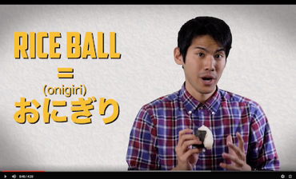
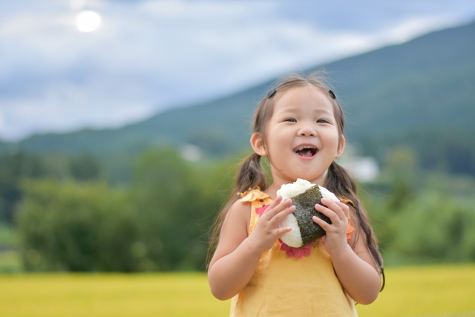
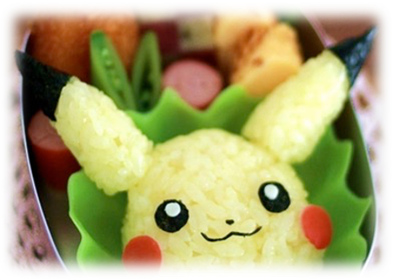
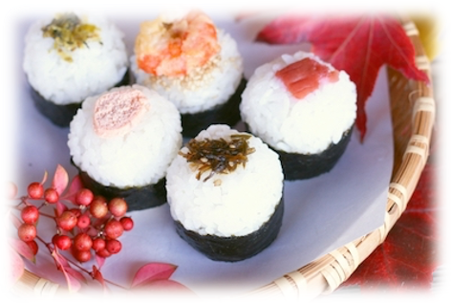
What is an “Onigiri”
Onigiri are Japanese Rice Balls
made from rice, seaweed, and different kinds of fillings,
such as fish, veggies, herbs - truly whatever you like!
https://youtu.be/gAguCK8WyG8
One of the most familiar food in Japan
Simple &
Easy to Make!
Can be Creative!
Versatile
& Tasty!
Eaten anytime!
for breakfast, lunch, a snack
Evolving every year!
Annual trend
Like sandwiches!
choose any filling you like
Notes:
So what is onigiri? Check out the video!
As you see in the video, onigiri (Japanese rice balls) are found everywhere in Japan. You can easily buy them premade in grocery stores or convenience stores. They are a quick easy meal, much like a sandwich in the United States, eaten for lunch, dinner, a snack – even breakfast! Fillings can include fish, veggies, herbs - truly whatever you like.

Slide 9
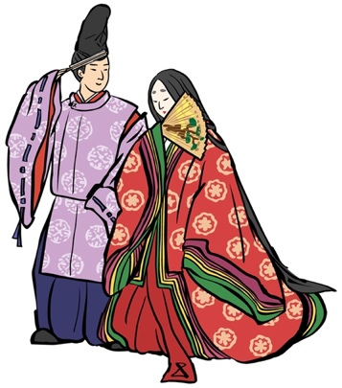
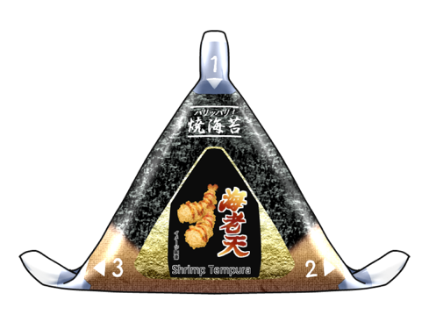
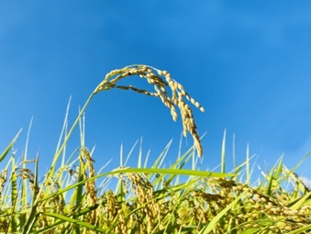
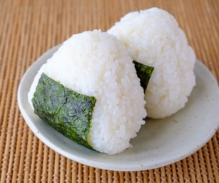
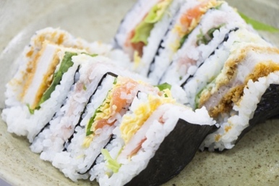
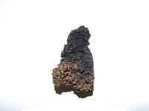
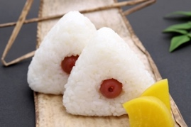
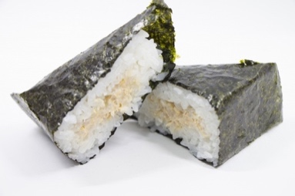
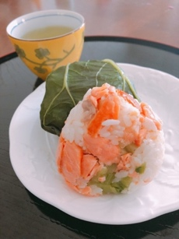
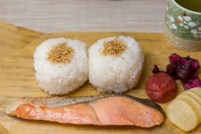
Onigiri Milestones
Nobles
Farmers / travelers
Office workers
/ students
The oldest article written about Onigiri
7-Eleven invented the wrapping film that keeps nori crisp
Rice cultivation begins
Norimaki Onigiri invented
Onigirazu
稲作の始まり
海苔の始まり
コンビニおにぎりの始まり
B.C.6000
B.C.1〜100
717 〜724
1221
1603〜1868
1889
1978
1983
1991
NOW
最古のおにぎり
梅干しの始まり
学校給食の始まり
The Oldest Onigiri Discovered
Onigiri with pickled plums distributed to samurai
Japan's first "school lunch" implemented
Tsuna Mayo
Gochiso Onigiri
中能登町役場ウエブサイトより
https://www.town.nakanoto.ishikawa.jp/soshiki/kikaku/5/2/2/1389.html
(and this led to the spread of pickled plums throughout Japan)
Samurai soldiers
School kids

Slide 10
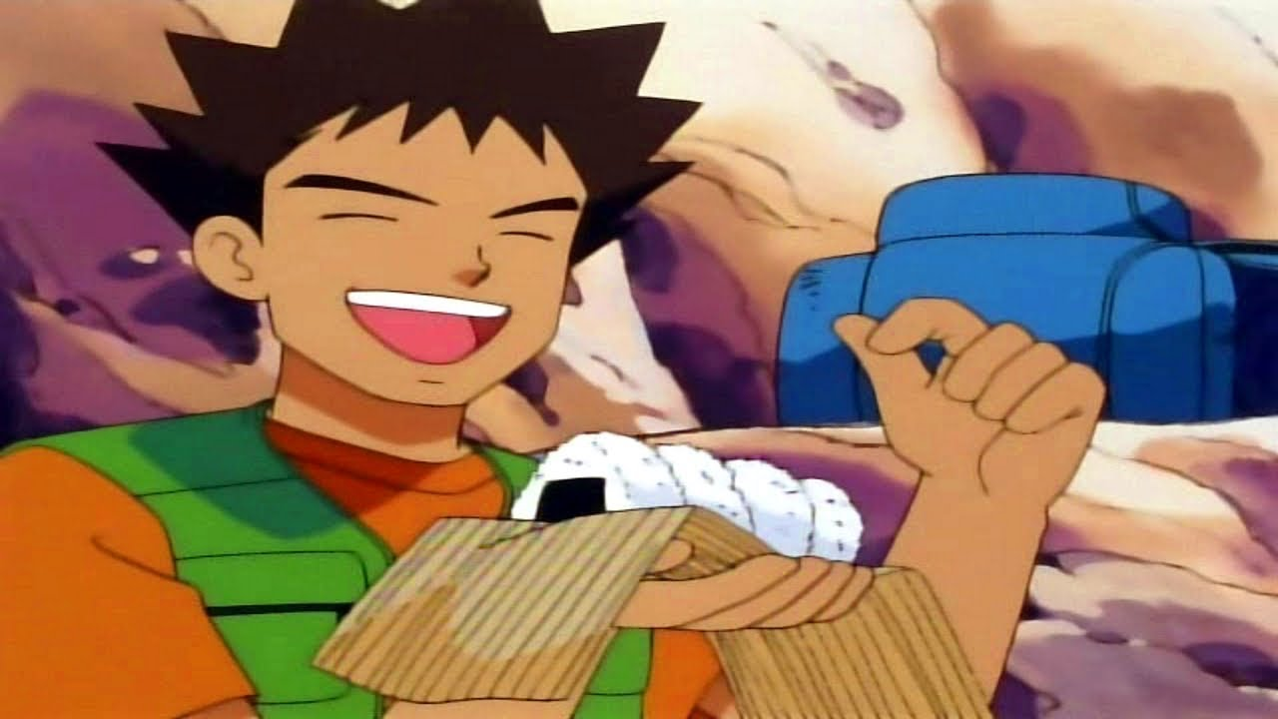
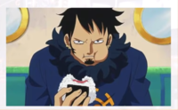
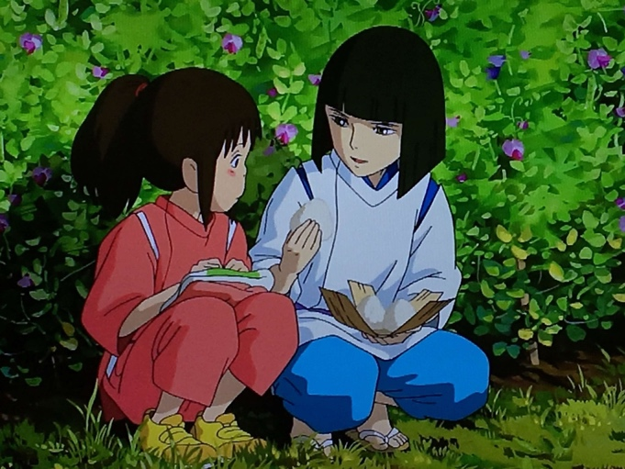
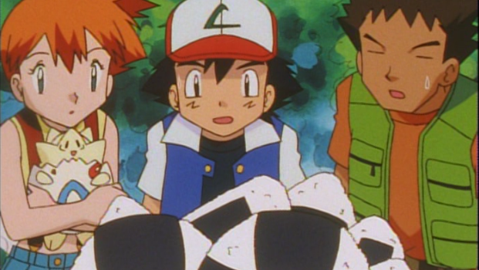
Onigiri in Anime
One Piece
Pokémon
Spirited Away
Since onigiri is an everyday food,
it often appears in anime scenes.
Notes:
We’ve come a long way since the dubbed Pokemon first aired in 1997. In order to localize in English Pokemon was dubbed and Onigiri was translated as onigiri as jelly donuts to adapt to the US audience.

Slide 11
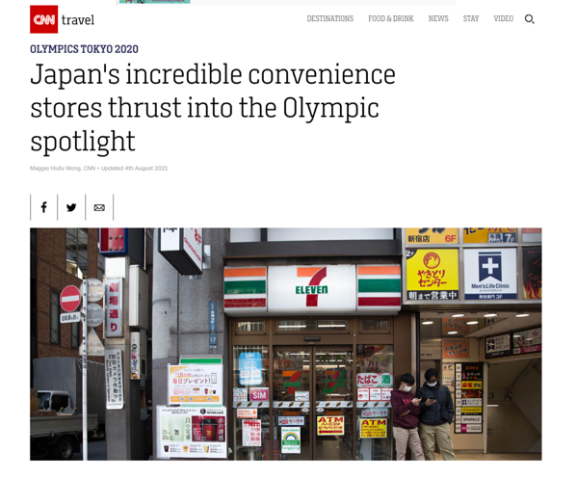
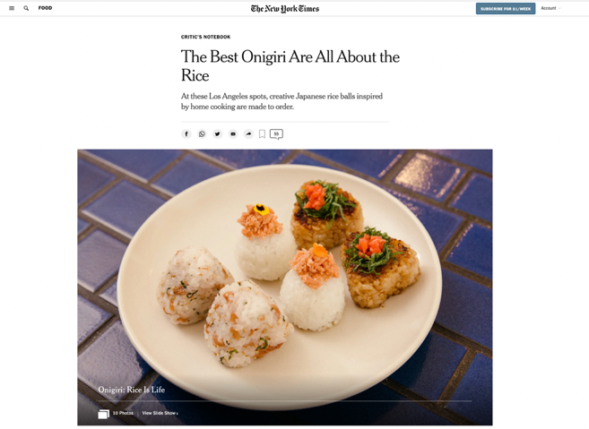
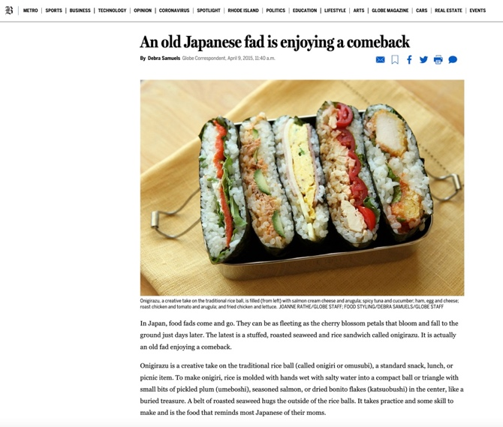
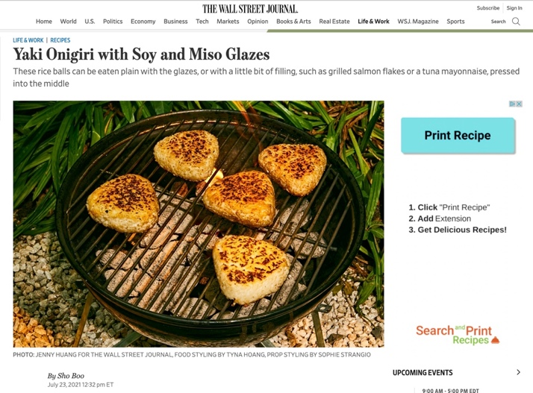
Onigiri Media Exposure in the US
CNN
The New York Times
Boston Globe
The Wall Street Journal
Recently, onigiri have been featured in the media more and more.
Notes:
Onigiri is now being features in mainstream media: Boston Globe, NYTimes, CNN, WSJ—about Onigiri itself, recipes and also where to buy them in the US!

Slide 12
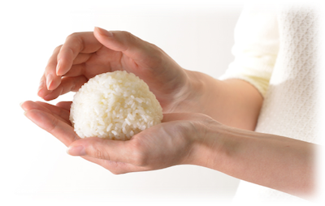
Why “Onigiri”?
Onigiri are also a symbol of love & care
Like a plate of warm chocolate chip cookies.
Onigiri are a comforting food that feel like home
As an NPO with roots in Japan,
TFT features Onigiri
to showcase the Japanese tradition
of making onigiri for loved ones.
Notes:
Rice balls are also an important comfort food, a symbol of love & care, in Japan. Like a plate of warm chocolate chip cookies or a bowl of chicken soup, rice balls remind one of home and feel cozy.
As an NPO with roots in Japan, TFT features Onigiri to celebrate rice, one of the major Japanese agricultural products, and showcases the Japanese tradition of making onigiri for loved ones.

Slide 13
LET’S COOK!

Slide 14
FOOD ALLERGY
***IMPORTANT***
If you have a Food Allergy
or any concerns or questions about the food, please let us know. Make sure to check ingredients information on the label.

Slide 15
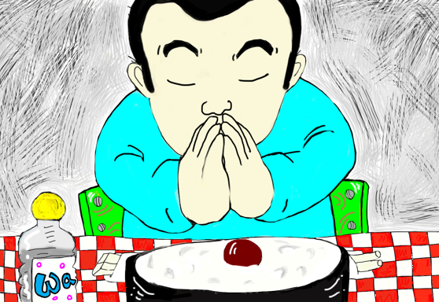
LET’S EAT!
いただきます
“ITADAKI MASU”
Thank you for the meal!
Notes:
Everyone waits to eat together. In the beginning of the meal you say:
Itadakimasu – I receive (with respect).
At the end of the meal: Gochisosama deshita – I have received (with respect)
This is acknowledgement and gratitude to the person who has cooked the meal and the people who have grown the food.
Let’s say it together. “Itadakimasu!”

Slide 16
Who is supported by TABLE FOR TWO?
The meals that are provided by the campaign
go to children all around the world from countries in
East Africa to parts of North America.
East Africa
North America
Southeast Asia
Notes:
There is need and food insecurity all around the world. The meals that are provided by the campaign go to children all around the world from countries in East Africa to parts of North America.

Slide 17
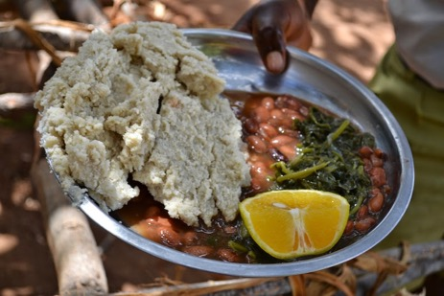
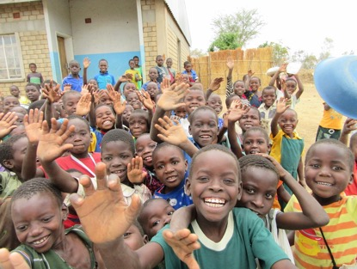
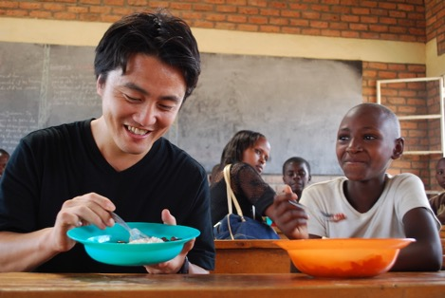
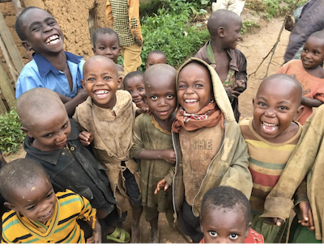
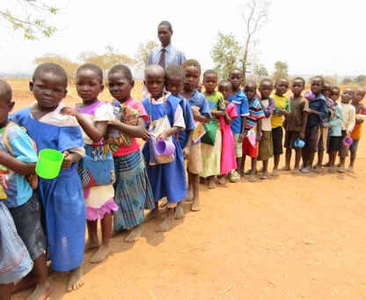
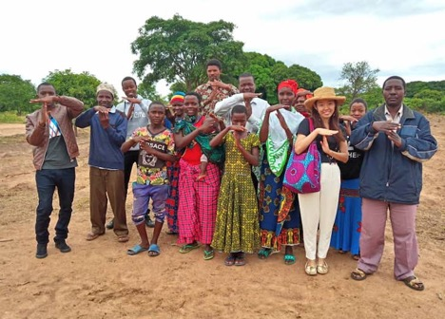
Who is supported by TABLE FOR TWO?
East Africa
Nutritious school meals transform education & the community
5)
Uganda
Kenya
Rwanda
Tanzania
Notes:
Nutritious school meals transform education & the community in East Africa. Table for Two members regularly visit these communities to check the results.

Slide 18
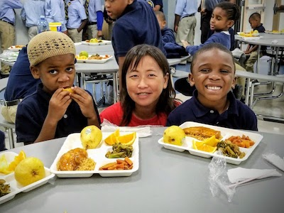
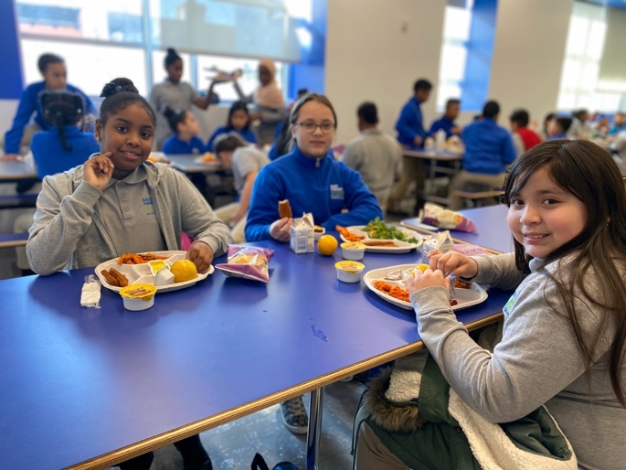
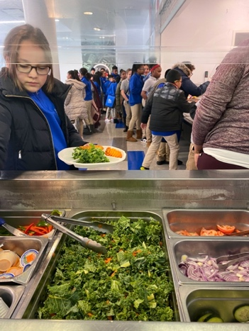
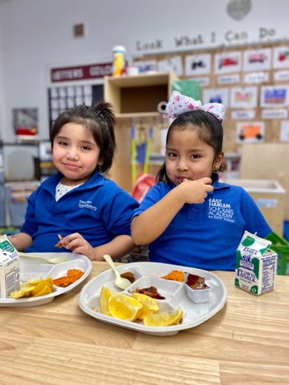
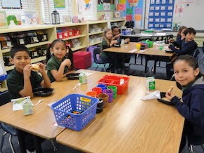
Who is supported by TABLE FOR TWO?
North America
Support to provide healthier school lunches in the US
Notes:
In North America (NY, DC, LA, New Jersey, Houston), we support to provide healthier school lunches in the US with fresh vegetables and fruits.

Slide 19
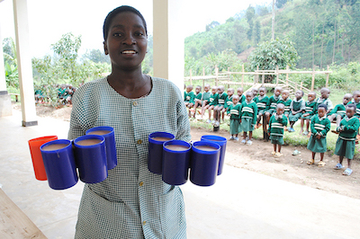
East Africa: Impact of school meals
Do you know how much impact
school lunch gives?
World Food Programme
Attendance Rate = 73%
increased to
97%
Graduation Rate = 60%
increased to
100%
School lunch is critical to health and academic performance
Your onigiri post makes children’s future bright!
Notes:
Being fed a warm meal has far reaching impacts. Thanks to receiving nutrition, the attendance rate (Click!) increased to 97% and graduation rate (Click!) increased to 100%.

Slide 20
How to join ONIGIRI ACTION
https://youtu.be/rGVpElPbDPM

Slide 21
Onigiri Photos – Onigiri-related photos
All these onigiri-related photos are counted!
Photo Booth Props
Onigiri Pose / Hand sign
Downloadable props available on the website!
Make an onigiri with your arms/hands!
Craft
Knitted by Amigurumi_Bokujo
Origami, paper craft, crochet, knitting, woodwork, etc.
Artwork
Illustration, drawing, painting, collage, etc.
Notes:
We welcome any photo that includes an image related to onigiri. This means it is totally fine to post scenes making onigiri, eating onigiri, dressing as onigiri, doing an onigiri pose or making onigiri hand signs, and creating onigiri from materials like paper, wood, yarn, cloth, colored pencils, etc. Unfortunately, video is not counted as a valid post, but any photos includes all types of onigiri are counted. And you can upload as many photos as you want. Be creative and enjoy ONIGIRI ACTION!

Slide 22
Onigiri Photo Map – Global campaign site
When you post onigiri photos on the global campaign website,
your photos will be located on the onigiri photo map.
https://onigiri-action.com/en/
Tibet
Germany
Japan
Uganda
Japan Foundation (LA)
Thanksgiving onigiri (Ohio)
Ambassador Sasae (DC)
Students (NJ)
Events (NYC)
Every year, people from around the world participate in the campaign
from school children to Ambassador Sasae to Uganda.
Notes:
This map shows the countries from which photos were contributed. Every year, people from all around the United States participate in our campaign from school children in New Jersey to Ambassador Sasae to Uganda. Some people get creative and even dress-up as an onigiri! Any form of onigiri counts – from a rice ball you make yourself to a picture of an onigiri that you draw. It is easy to participate!

Slide 23
Onigiri Photos –Instagram #OnigiriAction
Instagram
Notes:
The creativity of rice balls is amazing! Some are even shaped into characters like Minnie Mouse.

Slide 24
Help us fill the map of the U.S. with ONIGIRI!
We need onigiri photo posts from all 50 states!!!
We want to spread Onigiri Action across the country with posts from every state to increase participation and have fun with creative onigiri to bring even more school meals to children in need.
2021
Missed 10 states
2022
Missed 8 states
Delaware / Idaho / Iowa / Missisippi / Montana / New Hampshire / New Mexico / South Carolina / South Dakota / Wyoming
Arkansas / Delaware / Idaho / Nevada / New Hampshire / New Mexico /
South Dakota / West VIrginia
Do you have friends or family who live in these states?
Please encourage them to post Onigiri photos!
★

Slide 25
More Ways to Support!
Get ONIGIRI ACTION merch!
Your T-shirt purchase* will provide 30 school meals to children in need!.
https://www.bonfire.com/store/tablefor2
We appreciate your donation!
Text ONIGIRI to 44-321
to get a donation link!
Or visit
https://secure.givelively.org/donate/table-for-two-usa/onigiri-action
Notes:
Get ONIGIRI ACTION merch! Please visit https://www.bonfire.com/store/tablefor2
Your T-shirt purchase* will provide 30 school meals to children in need!
*All profits go to provide school meals to children in need. For example, when you purchase one item, 30 school meals will be provided, which means you can feed one child for a whole month.
We appreciate your donation! You can also support our cause directly by donating. Your 25 cents can provide a healthier school meal full of fresh fruits and vegetables to a student in the US or a healthy school meal to one student in Africa. Text ONIGIRI to 44-321 to get a donation link!
https://secure.givelively.org/donate/table-for-two-usa/onigiri-action

Slide 26
END OF THE MEAL
“GOCHISO SAMA
DESHITA”
Thank you for the meal!
Notes:
At the end of a meal you put down your chopsticks and say gochisosamdeshita. It means you have received your food and you are showing appreciation for the person who made the meal as well as those who grew the food.
Let’s say it together, “Gochiso-sama deshita!”

Slide 27
Post your photo with #OnigiriAction
Visit our website
Thank you!
ありがとう！
https://usa.tablefor2.org
Follow us on Instagram!
Follow us on Facebook!
★

